Slide 1
Selecting Neighborhoods when Moving to Austin, TX
An Exploration of Applied Data Science

Slide 2
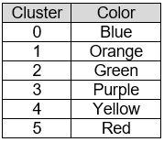
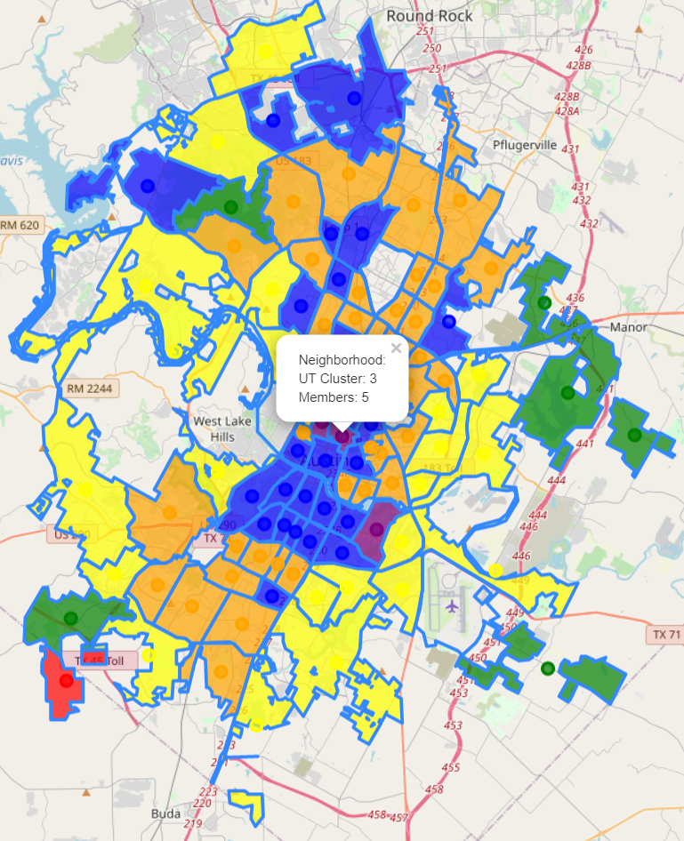
Contents
Overview
Why I Did It
How I Did It
What I Found
My Conclusions
Exploring for Yourself
Neighborhoods in Austin Clustered using K-Means Clustering

Slide 3
Overview
Data Science tools were used to analyze publicly available data with the intent of identifying different sets of neighborhoods someone might investigate as a place to live in Austin, TX
This included identifying sources of publicly available data, selecting specific datasources to use, and processing those data sources and analyzing the results
This was done with Jupyter Notebooks, Python, Pandas and the GeoPandas libraries, as well as Scikit-learn for K-Means Clustering, and Folium for creating maps

Slide 4
Why I Did It
Austin, TX is an interesting city, growing quickly at a rate of more than 100 people per day for several consecutive years
Outside of picking where to live based on a school district, there isn’t much publicly available data analyzing the cities neighborhoods – most of what is available is owned and controlled by large relator agencies
The use of K-Means Clustering against publicly available datasets seemed like an interesting opportunity to democratize both the data and Data Science

Slide 5
What I Did
Selected free publicly available data sources for analysis
GeoJSON file form Austin Open Data Portal for Neighborhood boundary data
Nearby venue data from Foursquare for each Neighborhood
Population, Rate, Ethnicity and Housing data from the Austin Demographic Data Site
Household and Age data from the Austin Demographic Data Site
Processed the data with Pandas, GeoPandas, and Scikit-learn to create K-Means Cluster data
Created colorized maps based on cluster assignment
Analyzed the characteristics of each cluster

Slide 6
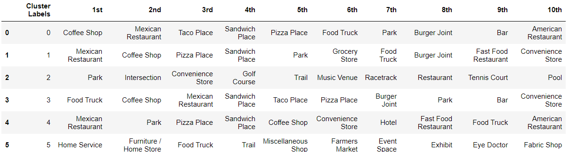
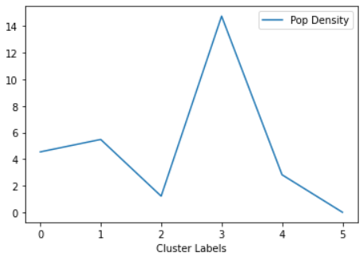
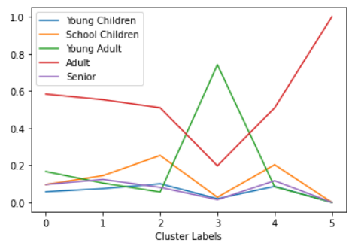
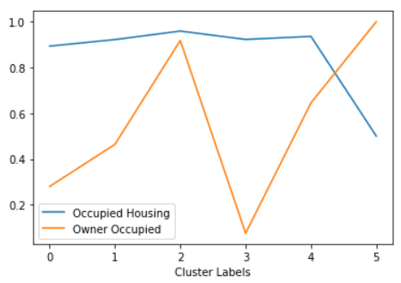
What I found
Most Common Venues by Cluster
Neighborhoods in Austin Clustered using K-Means Clustering

Slide 7
My Conclusions
Cluster | Color | Type | Occupied By | Population Density | Families | Children
0 | Blue | Residential | Renter | Medium | Mixed | Yes
1 | Orange | Residential | Mixed | Medium | Mixed | Yes
2 | Green | Residential Recreation | Owner | Low | High | Yes
3 | Purple | Residential | Renter | High | Low | No
4 | Yellow | Residential | Mixed | Medium Low | High | Yes
5 | Red | Rural | Owner | Low | High | No
Clusters 0 and 1 are very similar, with families and children. A closer look at the most common venues suggests that cluster 0 might be a little more ‘casual’, which 1 might be a little more family centric, being the only cluster with Grocery Stores in the top 10 frequently seen venues.
Cluster 2 again seems families with children, but it has a lower population density, and more recreational space in the top 10 venues than other clusters.
Cluster 3 is clearly centered on the University of Texas, with a preponderance of young adults, those most likely to be in college, low owner-occupation, and few families or children.
Cluster 4 is similar to clusters 0 and 1, though with lower population density and a higher percentage of families.

Slide 8
Exploring for Yourself
The original Jupyter Notebook, along with all the code, and details on how the data was processed is available on GitHub at Selecting Neighborhoods When Moving to Austin, TX.ipynb
Note the Folium maps aren’t viewable if using the GitHub UI – view the same document using the Jupyter Notebook Viewer with the link Jupyter Notebook Viewer - Selecting Neighborhoods When Moving to Austin, TX.ipynb
You can hover over neighborhood to get the name, or click the neighborhood marker to get the name and cluster when using the Jupyter Notebook Viewer
The Report of the analysis is available on GitHub at Selecting Neighborhoods when Moving to Austin.pdf
This document is available on GitHub at Selecting Neighborhoods when Moving to Austin, TX.pptx

